Slide 1



Schedulane
ITINERARIES
BUSAN

Slide 2


About
An intelligent travel planning assistant that generates personalized, adaptive, and logistically sound itineraries based on natural language queries. This project moves beyond generic "Top 10" lists to create truly unique travel experiences.

Slide 3
Type in your preferences and get your personalized itinerary

Slide 4
Current
Market &
our solution
PROBLEM
SOLUTION
Users must manually sift through hundreds of generic reviews to find places that match a specific vibe
Finding good places that are near each other is a burden users take on
We create a holistic, end-to-end travel planning ecosystem that generates personalized. Eliminating hours of manual research and preventing common travel frustrations like inefficient travel between locations
DEEPER CULTURAL IMMERSION
SUPPORTING LOCAL CULTURE
By creating walkable itineraries, the system encourages tourists to explore neighborhoods on foot. This fosters a more immersive and authentic travel experience
The system is designed to be time-sensitive, allowing it to recommend temporary local events like concerts and festivals.

Slide 5
HOW?

Slide 6
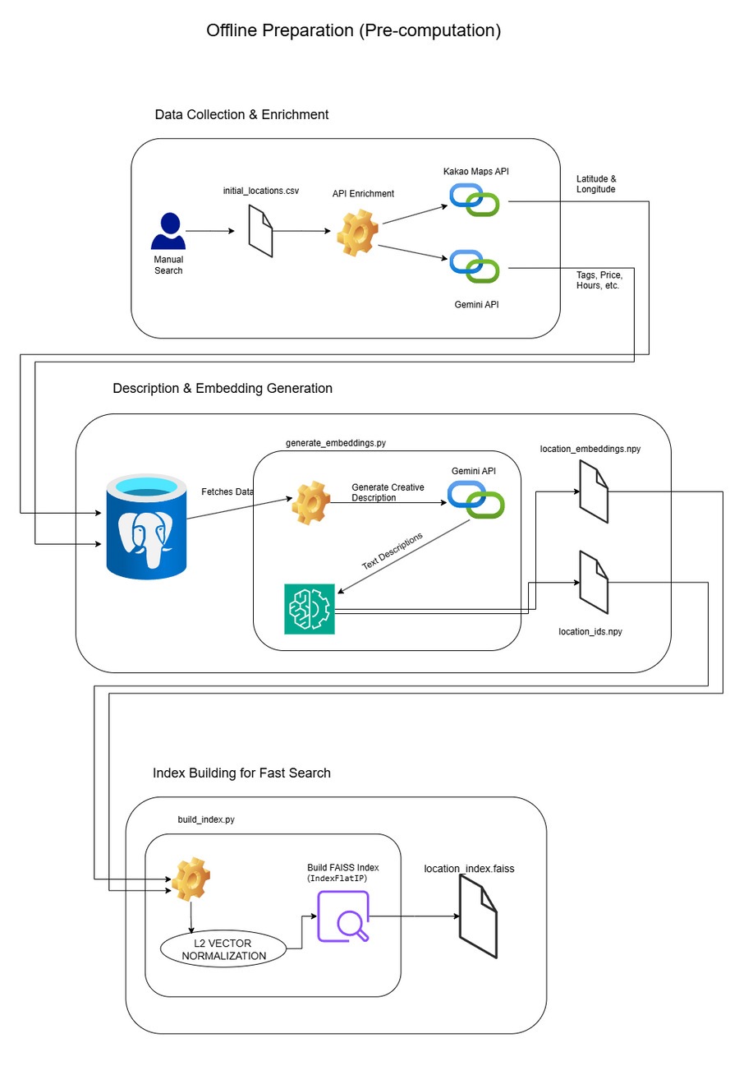
Phase 1: Offline Data Processing & Indexing
The goal of the offline phase is to transform raw location data from a relational database into a highly optimized format for high-speed semantic search. This process is executed periodically to keep the search index fresh.
AI-Powered Data Enrichment
The system uses a Large Language Model (LLM) to generate rich, descriptive paragraphs
Semantic Vector Embedding
To convert the generated text descriptions into numerical representations (vectors or "embeddings") that a machine can understand and compare
High-Speed Vector Indexing
To enable near-instantaneous search over millions of vectors

Slide 7
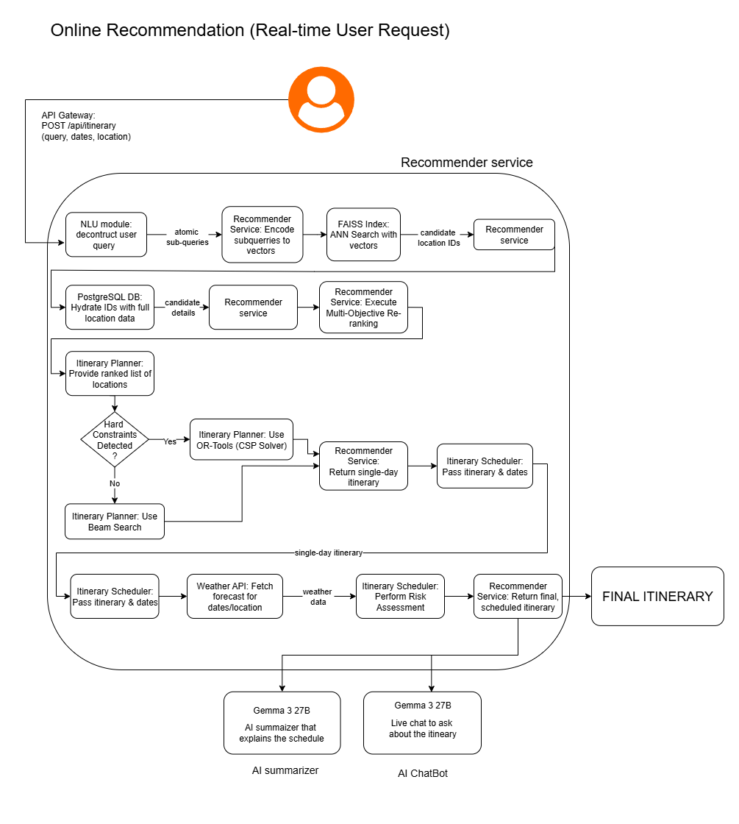
Phase 2: Online Real-Time Recommendation Engine
This is the live FastAPI microservice that handles user requests. The workflow is a multi-stage funnel designed to start with a broad set of candidates and progressively refine them into a final, optimized itinerary.
API Ingestion & Query Pre-processing
A POST request to /schedule receives the user's queries, location, and dates, validated against the ItineraryRequest Pydantic model
Candidate Retrieval (Recall Stage)
Each sub-query is encoded into a 384-dimension vector using the all-MiniLM-L6-v2 model
The vector is L2 normalized
retrieve the top k
Multi-Factor Reranking (Precision Stage)
refine the raw candidate pool using business logic and contextual factors
Itinerary Optimization & Planning
Assemble the ranked list of locations into a coherent, day-long schedule. A hybrid approach is used: Beam Search and Google OR-Tools' CP-SAT solver
Finalization and AI-Powered Summarization: The final schedule is checked against weather data from the OpenWeatherMap AP

Slide 8
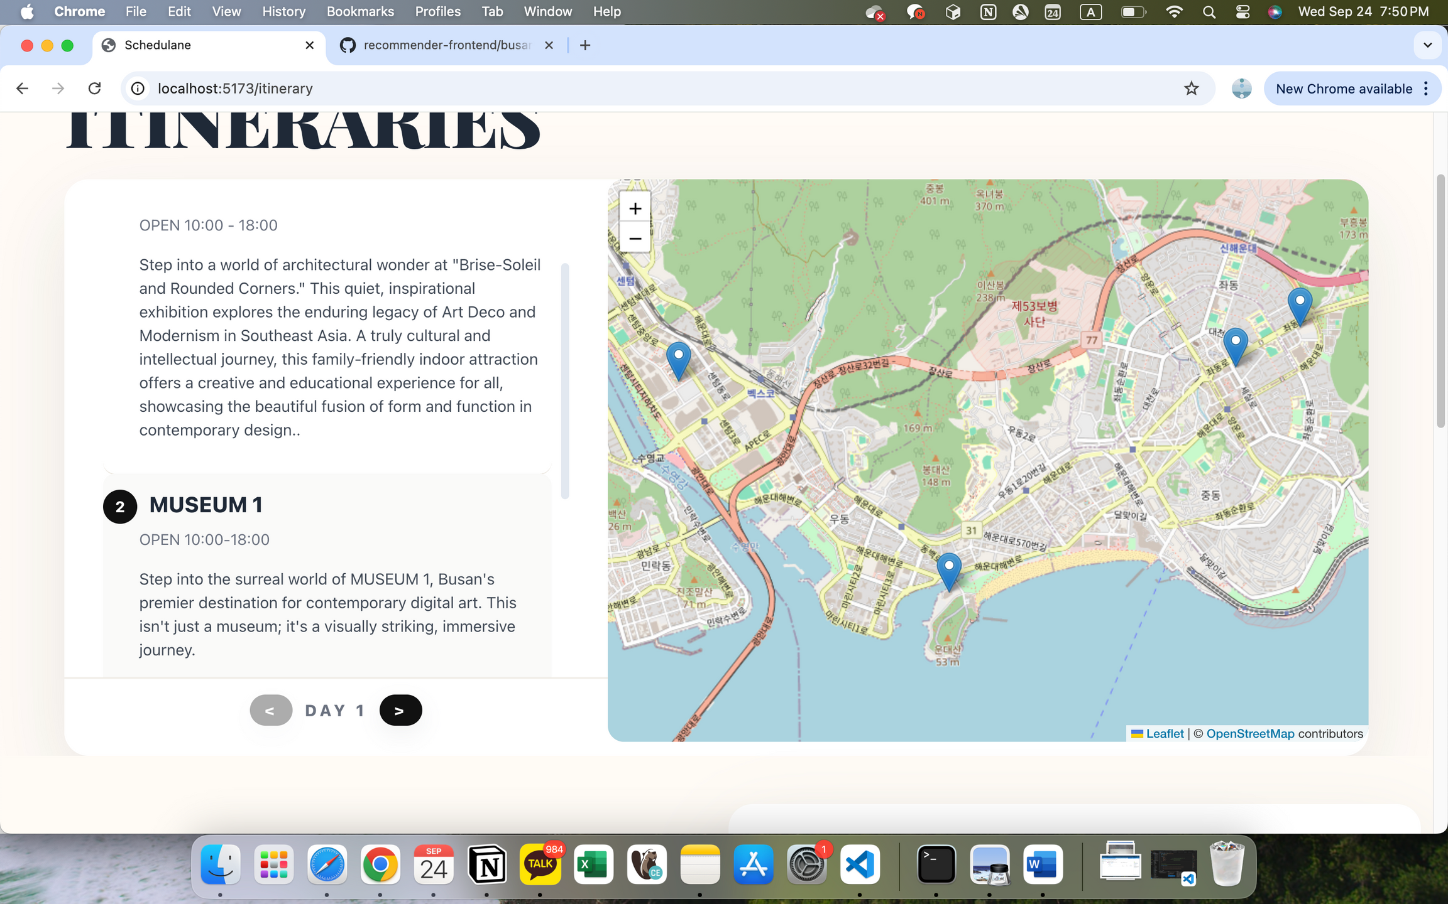
ITINERARIES

